Slide 1

Analyzing Multi-Block Data:
A Tutorial of Multiple Factor Analysis in R
Tony Dutcher, Matt Kmiecik, Derek Beaton
1. School of Behavioral Brain Sciences, The University of Texas at Dallas, 2. The University of Texas, Southwestern Medical Center, Department of Psychiatry

Slide 2
Overview
Data sets are getting big and complex.
Problems with wide data or multi-table.
Potential solution – Multiple Factor Analysis.
Beer!
More advance topics

Slide 3
Material
Found at:
http://www.derekbeaton.com/samr-swpa-2016/

Slide 4
Overview
Data sets are getting big and complex.
Problems with wide data or multi-table.
Potential solution – Multiple Factor Analysis.
Beer!
More advance topics

Slide 5
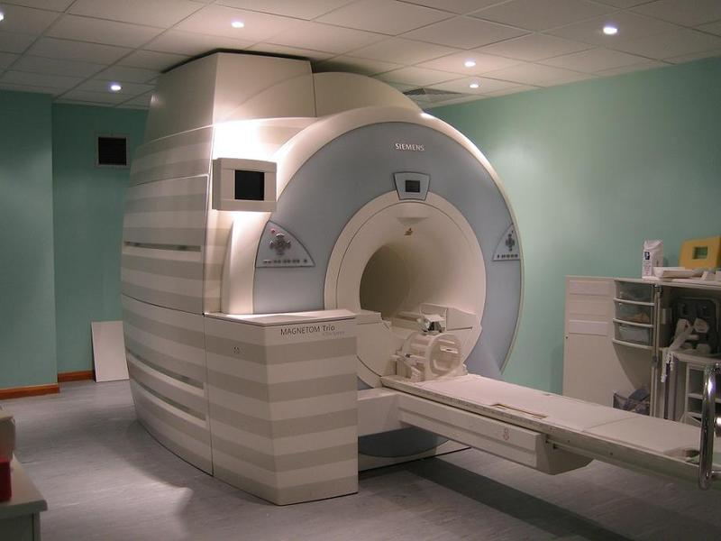
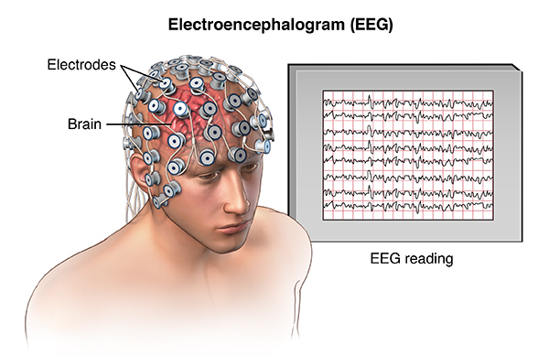
Data sets are getting large and more diverse
More devices to study human cognition and behavior yielding large datasets.
MRI
EEG
Notes:
I broke the animation… please fix. How much stuff is there

Slide 6
How do we represent large data?
time point 1
time point k
Participant K
 |  |  |  |  |  |  |  | …
S₁
S₂
S₃
S₄
S₅
S₆
voxel 1
voxel k
 |  |  |  |  |  |  |  |  | …
F_{z}
C_{z}
P_{z}
…
…
O_{z}
MRI
EEG
Notes:
I broke the animation… please fix. this slide and the previous combine the two together.
"keep mile high view" - quick concise

Slide 7
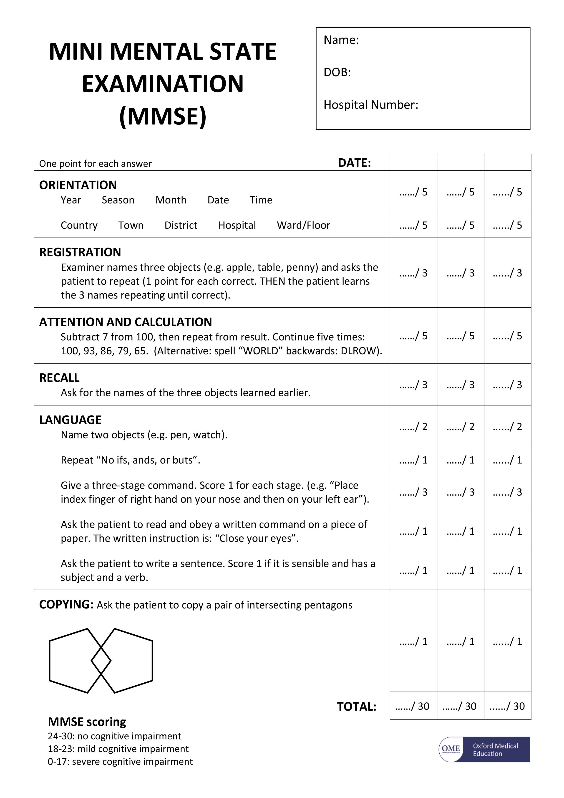
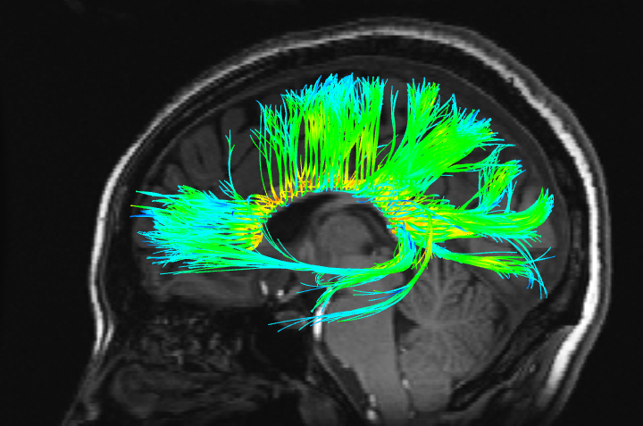

Data sets are getting large and more diverse
Behavior
Brains
Genes
Notes:
I broke the animation… please fix.
Behavior: be sure to talk about the potential different sizes of survey data i.e. 10 questions on a likert scale to 150 question personality inventory, to reaction time data.
Brain: Often behavior is a great place to start but imaging analysis is getting easier and easier to include. Further, including different types of imaging modalities – PET, MRI, fMRI, DTI, etc. → mention ADNI and other ‘biomarker’ type studies.
Genes: Why stop there? Genetic analysis is beginning to become more common place.
FINALLY, what about combining them all together?
all different types of data - more concise what do they look like when how big they are.

Slide 8
Representing data with matrices
Q₁
Q₂₀
S₂
S₂
S₃
S₄
S₁
voxel 1
… voxel 100,000
S₂
S₃
 | G | A | G | A | U | C | C | A | G | C | T | T | T | T | A | G | C | U | C | U | T | T | C | T | C | T | U | T | C | A | A | A | G | T | U | G | G | C | T | U | U | G | A | A
S₁
Behavior
Brains
Genes
… 1,000,000 + variables
Notes:
I broke the animation… please fix.
ordinal continuous categorical

Slide 9
What kind of data?
Not usually “Big Data” but “Wide Data” or “Multi-table data”
  Many many many more variables than observations
Qualitatively different kinds of data
AND! There is another type of structure, too: cubes…
Notes:
Slow down here and don’t talk too much about cubes until the next slide.
1. I will discuss the width issue, reiterating the different sizes of the matrices on the previous slide
2. Introduce idea that these types of data are qualitatively of different kinds.

Slide 10
Another type of data
Tensors
  “cubes of data”
  Rows, columns, and depth.
S₂
S₃
S₄
S₅
S₂
S₃
S₄
S₅
S₁
S₂
S₃
S₄
S₅
Delayed
Post
Pre
Notes:
MK’s attempt
We introduced this kind of data briefly when we talked about EEG data, where we have a matrix per participant with the rows as spatial locations and the columns as time-series, we essentially have more than two dimensions. Well along this line, we are representing participants in the rows and variables as the columns, but now introducing a third dimension – time. Tensors are well suited to data with an important time structure.
series of measures over time, clinical trials, introduce the design of an experiment and then put the design of experiment on data structure.

Slide 11
Brief aside!
The two types of data structures for today
Wide with multiple measures side-by-side spanning many of their own columns – multi-table data
  We will look at this kind of case first for you to follow along
A cube of same sized matrices
  We’ll show this one with snippets of R code
Code and data sets available for download.
Notes:
So, there has been a lot that has been introduced. Essentially, data today are getting larger, wider, and more complex. Today we are going to focus on two kinds of data, the wide data – where we want to align multiple measures side-by-side – we will go through an example of this and let you follow along.
Then, we are going to back to this idea of cubes when we dive into R and talk about beer!!

Slide 12
What to do with this much data?

Slide 13
What to do with this much data?
Usually
  make it smaller
  more digestible
  easy to interpret

Slide 14
The Go-to Method: PCA
Principal Components Analysis
PCA works on rectangular matrices
  Not cubes!
So, how can PCA fit our problems?

Slide 15
What to do with these data?
Multi-table: Just do a PCA and call it a day!
Cube: Average across the depth slices and call it a second day!
Not good ideas!
Notes:
Tony: with multi-table data, we take instruments of different kinds or multiple surveys, or brain and behavior and combine it together and run a PCA.
Not good ideas, we will demonstrate the good idea.

Slide 16
Even though these aren’t good ideas
Before we get to Multiple Factor Analysis (MFA), we need to understand Principal Components Analysis (PCA) first
Notes:
“These are not good ideas. However, before we get to the solution of multiple factor analysis, we first need to understand principal component analysis.”

Slide 17
What is PCA?
Data reduction technique that preserves the variance in the data matrix by creating latent variables called components.
Latent variables are a linear combination of original variables
Components are orthogonal
PCA is computed on rectangular matrices, usually with rows as the observations and columns as the variables.
Notes:
Animate bullet points

Slide 18
How does PCA work?
  First, preprocess the data to have a mean of 0 and unitary norm
Run a Singular Value Decomposition (SVD) on the preprocessed data
The SVD describes the underlying structure of the data matrix through three special matrices: P Δ Q^{T}.
  P describes the fundamental relationship between rows (observations)
  Q describes the fundamental relationship between columns (variables)
  Δ describes the variance in the data set, per component
In PCA, we are taking a linear combination of the original variables that maximizes the variance in new latent variables or components.
Notes:
Animate bullet points

Slide 19
Principal Components Analysis (PCA)
X
=
P
Δ
Q^{T}
 | Q1 | Q2 | Q3
SS₁
SS₂
SS₃
SS₄
SS₅
 | 1 | 2 | 3
SS₁
SS₂
SS₃
SS₄
SS₅
 | Q1 | Q2 | Q3
1
2
3
singular value
γ₁ | 0 | 0
0 | γ₂ | 0
0 | 0 | γ₃
decomposition

Slide 20
Principal Components Analysis (PCA)
P describes the relationship between observations.
Δ scales this relationship.
Q describes the relationship between variables.
X
=
P
Δ
Q^{T}
 | Q1 | Q2 | Q3
SS₁
SS₂
SS₃
SS₄
SS₅
 | 1 | 2 | 3
SS₁
SS₂
SS₃
SS₄
SS₅
 | Q1 | Q2 | Q3
1
2
3
singular value
γ₁ | 0 | 0
0 | γ₂ | 0
0 | 0 | γ₃
decomposition

Slide 21
Principal Components Analysis (PCA)
P describes the relationship between observations.
Δ scales this relationship.
Q describes the relationship between variables.
X
=
P
Δ
Q^{T}
 | Q1 | Q2 | Q3
SS₁
SS₂
SS₃
SS₄
SS₅
 | 1 | 2 | 3
SS₁
SS₂
SS₃
SS₄
SS₅
 | Q1 | Q2 | Q3
1
2
3
singular value
γ₁ | 0 | 0
0 | γ₂ | 0
0 | 0 | γ₃
decomposition

Slide 22
Principal Components Analysis (PCA)
P describes the relationship between observations.
Δ scales this relationship.
Q describes the relationship between variables.
X
=
P
Δ
Q^{T}
 | Q1 | Q2 | Q3
SS₁
SS₂
SS₃
SS₄
SS₅
 | 1 | 2 | 3
SS₁
SS₂
SS₃
SS₄
SS₅
 | Q1 | Q2 | Q3
1
2
3
singular value
γ₁ | 0 | 0
0 | γ₂ | 0
0 | 0 | γ₃
decomposition

Slide 23
Principal Components Analysis (PCA)
P describes the relationship between observations.
Δ scales this relationship.
Q describes the relationship between variables.
X
=
P
Δ
Q^{T}
 | Q1 | Q2 | Q3
SS₁
SS₂
SS₃
SS₄
SS₅
 | 1 | 2 | 3
SS₁
SS₂
SS₃
SS₄
SS₅
 | Q1 | Q2 | Q3
1
2
3
singular value
γ₁ | 0 | 0
0 | γ₂ | 0
0 | 0 | γ₃
decomposition

Slide 24
Principal Components Analysis (PCA)
P describes the relationship between observations.
Δ are singular values, Δ² are eigenvalues (variance, per component)
Q describes the relationship between variables.
X
=
P
Δ
Q^{T}
 | Q1 | Q2 | Q3
SS₁
SS₂
SS₃
SS₄
SS₅
 | 1 | 2 | 3
SS₁
SS₂
SS₃
SS₄
SS₅
 | Q1 | Q2 | Q3
1
2
3
singular value
γ₁ | 0 | 0
0 | γ₂ | 0
0 | 0 | γ₃
decomposition

Slide 25
Principal Components Analysis (PCA)
We have components, which are new (orthogonal) variables, created from the original variables.
X
=
P
Δ
Q^{T}
 | Q1 | Q2 | Q3
SS₁
SS₂
SS₃
SS₄
SS₅
 | 1 | 2 | 3
SS₁
SS₂
SS₃
SS₄
SS₅
 | Q1 | Q2 | Q3
1
2
3
singular value
γ₁ | 0 | 0
0 | γ₂ | 0
0 | 0 | γ₃
decomposition

Slide 26
PCA – Row Factor Scores
Visualizing the relationship between observations with respect to the variance per component:
P
Δ
=
F_{I}
*
 | 1 | 2 | 3
SS₁
SS₂
SS₃
SS₄
SS₅
 | F₁ | F₂ | F₃
SS₁
SS₂
SS₃
SS₄
SS₅
F₁
γ₁ | 0 | 0
0 | γ₂ | 0
0 | 0 | γ₃
F₂
Notes:
Slow down here, and we have to expand this by one slide: show a box around F1 and F2, then show that these are the two axes in the graph.
Also label points on that graph as “SS1” through “SS1”

Slide 27
Scree plot and eigenvalues
Δ
γ₁ | 0 | 0
0 | γ₂ | 0
0 | 0 | γ₃
Notes:
When this pops up, just a call back to SVs vs. EVs – remind them that EVs are SVs squared. And we can plot them in this way to help identify which components might be most useful. Which is called a Scree plot.
Tony: Essentially, this EV matrix holds the variance of the original data table, recombined along the different components and each of these components is orthogonal to the other. Scree plots (reference to Cattell here), plot the values of the EV matrix both in a raw EV form but, can also get an idea for the percent of total variance each EV account for. Also, this plot is quite important for letting us know which variables we should focus on. Often people decide which EVs are important based upon an when the plot begins to asymptote or flatten out along the X axis. If we were going to visualize this data we would most likely only focus on the 1st and 2nd component. THERE ARE OTHER, MORE SCIENTIFICALLY SOUND WAYS TO DETERMINE WHICH COMPONENTS TO FOCUS ON – SEE OTHER TALK?

Slide 28
PCA – Row Factor Scores
Visualizing the relationship between observations with respect to the variance per component:
P
Δ
=
F_{I}
*
 | 1 | 2 | 3
SS₁
SS₂
SS₃
SS₄
SS₅
 | F₁ | F₂ | F₃
SS₁
SS₂
SS₃
SS₄
SS₅
F₁
γ₁ | 0 | 0
0 | γ₂ | 0
0 | 0 | γ₃
F₂
Notes:
Slow down here, and we have to expand this by one slide: show a box around F1 and F2, then show that these are the two axes in the graph.
Also label points on that graph as “SS1” through “SS1”
Show the matrices and quickly get to the plot!
Tony: Walk through the matrices and show how even when we get to the matrix F1 it is still difficult to understand, its still a big matrix with numbers. However, with PCA we can represent these relationships geometrically, with a plot. We can take this first component here and make it our X axis. Next we can take the second component and because these two variables are orthogonal, we can plot the second component on the Y axis (walk through animations with this).
Now, what about the rows or our participant observations? Well we can simply plot them (walk through each row being plotted. Now, we can understand the relationship between observations along these two components much better. MAYBE INCLUDE THIS? → WE COULD EVEN TALK ABOUT BRIEFLY HOW, NOW WE KNOW BLUE DOT AND RED DOT DIFFER IN THE RESPONSES ON THIS FIRST COMPONENT AND RED DOT AND ORANGE DOT DIFFER IN THERE RESPONSES ON THE SECOND COMPONENT.

Slide 29
PCA – Column Factor Scores
Factor scores for the columns represent the relationship between the variables.
Q
Δ
=
F_{J}
*
 | 1 | 2 | 3
Q1
Q2
Q3
 | F₁ | F₂ | F₃
Q1
Q2
Q3
F₁
γ₁ | 0 | 0
0 | γ₂ | 0
0 | 0 | γ₃
F₂
Notes:
Same thing here, but faster than the row scores slide.

Slide 30
PCA - Contributions
Contributions tell us how much variance each item contributes to the component
  If items are related, we can sum many of them together (contributions are additive)
Contributions are squared factor scores, divided by eigenvalues
F_{J}²/Δ²
 | F₁ | F₂ | F₃
Q1
Q2
Q3
F₁
F₂
Notes:
Call back to eigens. Mention that this is a useful feature to help interpret, but it can help us more when we get to MFA and have to know how *many things* contribute together.
Tony: Walk through bullet points and the equation. “Of course we can understand this geometrically. We can visualize contributions by looking at a particular observations/variables distance from the origin. So, lets say we want to understand what variables are contributing most to the first two components. First, lets plot our variables with our variable factor scores for the first two components, like we just did. Now, we can understand contributions as distance from the origin. So, with these purple arrows, we can see from the origin of component 1, each variable Is contributing somewhat equally to the first component but in opposite ways. Next, with the green arrows we can see the yellow dot it contributing much more to the variance of the second component, than compared to the red dot. So, we can say the yellow variables contributes a large amount of variance to the first two components, while the red variable contributes to the first but not the second component. FUTHER, IF WE WERE TO PLOT ALL THE VARIABLES AND ADD UP ALL THE PURPLE LINES (CONTRIBUTIONS) THEN WE WOULD GET THE VARIANCE OF COMPONENT 1! SIMILARLY, IF WE ADDED UP ALL THE GREEN LINES (CONTRIBUTIONS) THEN WE WOULD GET THE VARIANCE OF COMPONENT 2!

Slide 31
What do PCA results look like?
Let’s do a PCA of two different data sets measured on the same individuals: one on paranoia, and one on trait anxiety.
Notes:
Note: don’t say that these data (surveys) are real – they are simulated.

Slide 32
What do PCA results look like?
First, paranoia.
  N=60 (20 Control, 20 Psychosis, 20 Social Anxiety)
  20 questions (variables)
Notes:
DB will fill this in later.

Slide 33
The data
Paranoia Scale
20 Questions
P1
P2
P3
…
P58
P59
P60

Slide 34
The data
Preprocess each column to have a mean of 0, and unitary norm
  i.e., the sum of squares is equal 1
So, the total SS (i.e., total variance) for the table is the number of columns
  Here: 20
Paranoia Scale
20 Questions
P1
P2
P3
…
P58
P59
P60
SS=
1 | 1 | 1 | 1 | 1 | 1 | 1 | 1 | 1
Notes:
Tony: read bullet point. Reiterate, so we know that our sums of squares or our variance in this data table is 20. Now, lets run a PCA on this data!

Slide 35
The results – eigenvalues
Notes:
When this pops up, just a call back to SVs vs. EVs – remind them that EVs are SVs squared. And we can plot them in this way to help identify which components might be most useful. Which is called a Scree plot.
Quiz SS table and plot the same.
Tony: All right, first things first. We want to look at a scree plot. This will show us how the original variance was recombined in these latent variables or components. This helps us determine which components are most useful – transitions to next slide here, i.e. THIS IS THE VARIANCE

Slide 36
The results – a.k.a. variance
Notes:
Transitioned from previous slide, i.e. THIS IS THE VARIANCE. Again, this plot will help us determine which EVs we want to look at for our analysis.

Slide 37
The results – a.k.a. variance
Quiz:
What is the sum of the eigenvalues?

Slide 38
The results – a.k.a. variance
4.033
Quiz:
What is the sum of the eigenvalues?
2.238

Slide 39
The results – a.k.a. variance
Quiz:
What is the sum of the eigenvalues?
20!
Where do we know that from?
Notes:
Tony: Hmmm, this number looks very familiar, where ever could it be from? The original data table of course! --- probably won’t include this line, maybe.
“Alright, so we have our variance successfully recombined via the PCA and we know we want to look at the first two components.

Slide 40
The results - rows
Notes:
Slow down a bit here to explain what they are seeing.
Tony: Moving on from the Scree plot, we now get our factor score plot. This plot tells us something about the relationship between observations. So we can see all of our participants here, lets look at a few… We can see p.76 and p.21 (animate) are very close to one another. Well this probably means that these participants are similar to one another, or they responded similarly to the scale. We can see this all over the plot (animate a few groups), where similar pairs or groups of people responding similarly. Furthermore, we can see that con.6 and SA.36 are responding oppositely on component 2 (animate), we can see another ‘opposite’ relationship between participants when looking at p. 41 and con. 1. (animate) – things at opposing ends mean these observations responded oppositely on the same variables. So in this plot we can begin to see similarities and differences between individuals along the first two components.
Finally/But that’s not all, bringing back contributions (represented by size of dot!), we can see that further away from the origin, the more the individual contributes to the analysis i.e. con. 6 to component 2, p. 41 to component 1., con. 1 to component 1, etc.
Additionally, we added a post-hoc coloring scheme to identify the different groups, since we know there is a group structure on the participants. We can see the groups separating out quite nicely. We can then better make sense of the first component, which seems to gradient paranoia. On one end we get the controls on the other we get the paranoia participants and in the middle we get socially anxious individuals…….
What about the variables?

Slide 41
The results – columns
Notes:
Slow down a bit here to explain what they are seeing.
Well, we can see all the paranoia scale questions clustering to the right, well this makes sense given that our paranoia individuals were all over here as well, thus we can see that paranoia individuals are rating higher on this scale. ALSO, controls, since they were on the opposite end of the first component, we know they responded in opposite ways than the paranoia individuals. Further, we can also look at contributions again (size of the dot!). We can get a sense of the variables that are contributing most to the first two components.

Slide 42
Now we’re experts on PCA!

Slide 43
Overview
Data sets are getting big and complex.
Problems with wide data or multi-table.
Potential solution – Multiple Factor Analysis.
Beer!
More advance topics
Notes:
multi-block, multi-table, introduce this earlier
Tony: So we just went over large, complex data sets and how PCA is often used as the go to method to make the data more interpretable.
MFA is a solution for when you have multiple data tables that need to be analyzed together OR a large data set that have a complex or multi-dimensional structure.

Slide 44
Back to multi-table data
Can we just put a bunch of data side-by-side and do PCA?
  We can… but we shouldn’t.
So, what can we do?
A simple “two-table” example

Slide 45
Brief data description
Paranoia Scale (PS) & Trait Anxiety (TA)
  Same N=60 (20 Control, 20 Psychosis, 20 Social Anxiety)
  PS has 20 questions
  TA has 11 questions
Notes:
DB to fill in later

Slide 46
Principal Component Analysis (PCA)
Paranoia Scale + Trait Anxiety Scale
31 Questions

Slide 47
Principal Component Analysis (PCA)
Paranoia Scale + Trait Anxiety Scale
31 Questions
31
PCA
1
2
Sums of Squares
Notes:
We should adjust these values to match the PS and TA – DB can do this later.

Slide 48
Principal Component Analysis (PCA)
Paranoia Scale + Trait Anxiety Scale
31 Questions
31
Table | SS | %
Total | 31 | 100%
Sums of Squares
Notes:
We should adjust these values to match the PS and TA – DB can do this later.

Slide 49
Principal Component Analysis (PCA)
Paranoia Scale |  |  |  |  |  |  |  |  |  | Trait Anxiety
20 Questions |  |  |  |  |  |  |  |  |  | 11 Questions
Notes:
We should adjust these values to match the PS and TA – DB can do this later.
We can do a PCA on this BUT wait, we know there is a structure here.

Slide 50
Principal Component Analysis (PCA)
Paranoia Scale |  |  |  |  |  |  |  |  |  | Trait Anxiety
20 Questions |  |  |  |  |  |  |  |  |  | 11 Questions
Notes:
We should adjust these values to match the PS and TA – DB can do this later.

Slide 51
Principal Component Analysis (PCA)
Paranoia Scale |  |  |  |  |  |  |  |  |  | Trait Anxiety
20 Questions |  |  |  |  |  |  |  |  |  | 11 Questions
Notes:
We should adjust these values to match the PS and TA – DB can do this later.

Slide 52
Principal Component Analysis (PCA)
Paranoia Scale |  |  |  |  |  |  |  |  |  | Trait Anxiety
20 Questions |  |  |  |  |  |  |  |  |  | 11 Questions
20 |  |  |  |  |  |  |  |  |  | 11
Sums of Squares
Notes:
We should adjust these values to match the PS and TA – DB can do this later.

Slide 53
Principal Component Analysis (PCA)
Paranoia Scale |  |  |  |  |  |  |  |  |  | Trait Anxiety
20 Questions |  |  |  |  |  |  |  |  |  | 11 Questions
20 |  |  |  |  |  |  |  |  |  | 11
Table | SS | %
PS | 20 | 65%
TA | 11 | 35%
Sums of Squares
Notes:
Tony: Hmm… Well this might be a problem, lets look at the PCA results for the variable factor scores to get a better idea.

Slide 54
Principal Component Analysis (PCA)
Notes:
We should adjust these values to match the PS and TA – DB can do this later.
Tony: Again, remember that the column factor scores are what allow us to see how the different variables are influencing components. And recall that when you see two dots they are closer together that are highly similar (animate) small circle quad 4 and small circle quad 1 for TA. Well not only are they highly similar but they are collinear.
We can also look at the contributions here and remember we understood contributions as those variables that were furthest away would contribute more to the variance of that component. We can see that PS seems to have quite a few variables all contributing heavily to the first two components, but also there are many that are very similar or collinear with each other (large circle quad 4).
If we were to add all the contributions, we would see that PS, because it’s variables are more in number and further away from the origin (animate, animate) are dominating the analysis. But is this fair? Especially, if many of the contributions are collinear. Further, we know that the SS of PS is just larger simply because it has more variables, more variance on account of size.
Is this fair? If something is bigger should it automatically dominate? It doesn’t seem like it.
Transition – So I have been alluding to understanding contribution or influence of whole tables through the sum of the variable contributions but we can look at this more clearly and efficiently.

Slide 55
Partial Inertias
A quick definition we’ll need
What are Partial Inertias?
  Each variable contributes variance to each component
  So, we can add up these contributions if there is some structure to them
  So, let’s sum the variance contributed by the PS and the TA to both Components 1 and 2
Notes:
Tony: First, all inertia means is variance. These are called partial because of each it represents the variance of each table, all the tables together, giving us the “whole” inertia. Inertia is variance.

Slide 56
Partial Inertias
Component 2
Component 1
Notes:
So, these dots represent the SUM of the contributions for 20 items and 11 items (per instrument), for Components 1 (horizontal) and 2 (vertical) respectively.
Explain this slowly – if we just treat all columns as equal—ignoring that we have two structures, then the variance for the first two components is dominated by PS and TA is a wimp.
Draw a square showing that the area is just more for PS vs TA.

Slide 57
Don’t do what we just did!
We already knew that the PS and TA provide a different amount of variance (sums of squares)
  The results are now biased toward the PS simply because there are more columns!
So, how do we fix this?

Slide 58
Overview
Data sets are getting big and complex.
Problems with big data.
Potential solution – Multiple Factor Analysis.
Beer!
More advance topics

Slide 59
What is Multiple Factor Analysis?
MFA
A PCA-based technique for multi-table analyses
A multi-table technique
  Use the SVD (a two-way decomposition) for tensor-like data
Notes:
We’ll just have a few extra things to say here, but won’t pt them on the slide.

Slide 60
How does MFA work?
Each table must be normalized
Usually, by dividing each table by its first singular value.
  Analogous to z-scores.
Notes:
Tony: One of the simplest and most common ways to do this is to divide by the first singular value of the table.

Slide 61
Let’s take a look at a visualization

Slide 62
Multiple Factor Analysis – Step 1
X₁
X₂
X₃
Notes:
Matt

Slide 63
Multiple Factor Analysis – Step 1
X₁
X₂
X₃
For example…
Survey 1
Survey 2
Survey 3
Notes:
Matt

Slide 64
Multiple Factor Analysis – Step 1
X₁
X₂
X₃
Notes:
Matt

Slide 65
Multiple Factor Analysis – Step 1
X₁
X₂
X₃
For example…
Brains
Genes
Behavior
Notes:
Matt

Slide 66
Multiple Factor Analysis – Step 1
X₁
X₂
X₃
Notes:
Matt

Slide 67
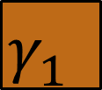
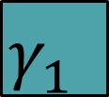
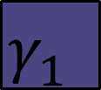
Multiple Factor Analysis – Step 1
X₁
P
γ₁ | 0 | 0
0 | γ₂ | 0
0 | 0 | γ₃
Q^{T}
PCA
$$γ_{1}^{}$$
X₂
P
γ₁ | 0 | 0
0 | γ₂ | 0
0 | 0 | γ₃
Q^{T}
$$γ_{1}^{}$$
PCA
X₃
P
γ₁ | 0 | 0
0 | γ₂ | 0
0 | 0 | γ₃
Q^{T}
$$γ_{1}^{}$$
PCA
Notes:
Matt

Slide 68



Multiple Factor Analysis – Step 2
X₁
Z₁
x
$$γ_{1}^{−1}$$
=
X₂
Z₂
x
$$γ_{1}^{−1}$$
=
X₃
Z₃
x
$$γ_{1}^{−1}$$
=
Notes:
divide by 1st singlular value, to get a Z like matrix

Slide 69
Multiple Factor Analysis – Step 3
Z₁
Z₂
Z₃
Notes:
The goal of steps 1 and 2 were to give us tables that are now normalized; normalization here is analogous to Z-scores, but for an entire matrix. The first singular value of each of these tables now is equal to 1.

Slide 70
Multiple Factor Analysis – Step 3
Compromise Table
Notes:
Matt

Slide 71
Multiple Factor Analysis – Step 4
Compromise Table
PCA
1
2
Notes:
Matt
Tony: Then we run a PCA on this wide, multi-table, compromise table.
---------Should we introduce a potential problem being the loss of the individual table scores? Or now all the tables are in a single analyses etc.?? With partial factor scores as a solution.

Slide 72
Recall PCA
If we have a structure on X then this structure propagates through the decomposition.
X
=
P
Δ
Q^{T}
 | Q1 | Qn | Q_{N}
SS₁
SS₂
SS₃
SS₄
SS₅
 | 1 | 2 | 3
SS₁
SS₂
SS₃
SS₄
SS₅
 | Q1 | Qn | Q_{N}
1
2
3
singular value
γ₁ | 0 | 0
0 | γ₂ | 0
0 | 0 | γ₃
decomposition

Slide 73
Recall PCA
So if we have a structure in X on the columns…
X
=
P
Δ
Q^{T}
 | Q1 | Qn | Q_{N}
SS₁
SS₂
SS₃
SS₄
SS₅
 | 1 | 2 | 3
SS₁
SS₂
SS₃
SS₄
SS₅
 | Q1 | Qn | Q_{N}
1
2
3
singular value
γ₁ | 0 | 0
0 | γ₂ | 0
0 | 0 | γ₃
decomposition
Notes:
Tony: So, if X has a structure, for instance if the teal variables belonged to one scale and the purple to another. Then, Q would have this same structure.

Slide 74
Recall PCA
Then Q also has that structure.
X
=
P
Δ
Q^{T}
 | Q1 | Qn | Q_{N}
SS₁
SS₂
SS₃
SS₄
SS₅
 | 1 | 2 | 3
SS₁
SS₂
SS₃
SS₄
SS₅
 | Q1 | Qn | Q_{N}
1
2
3
singular value
γ₁ | 0 | 0
0 | γ₂ | 0
0 | 0 | γ₃
decomposition
Notes:
Tony: The structure would propagate through these special matrices to this variable matrix.

Slide 75
Recall PCA
We can use this structure to perform partial projections.
X
=
P
Δ
Q^{T}
 | Q1 | Qn | Q_{N}
SS₁
SS₂
SS₃
SS₄
SS₅
 | 1 | 2 | 3
SS₁
SS₂
SS₃
SS₄
SS₅
 | Q1 | Qn | Q_{N}
1
2
3
singular value
γ₁ | 0 | 0
0 | γ₂ | 0
0 | 0 | γ₃
decomposition
Notes:
Tony: This can give us partial projections OR projections from the individual variables of the individual tables

Slide 76
Multiple Factor Analysis – Step 5
Compromise Table
Notes:
Tony: Going back, we have our compromise table and we have an inherent structure in this table

Slide 77
Multiple Factor Analysis – Step 5
Z₁
Z₂
Z₃
Notes:
Tony: (illustrate previous point here)

Slide 78
Multiple Factor Analysis – Step 5
Z₁
Z₂
Z₃
Q
Notes:
What do we need here???????
My notes say that we need some sort of transition here, but I can’t recall what…
Tony: We know that this structure is also inherent to the Q matrix.

Slide 79
Multiple Factor Analysis – Step 5
Z₁
Z₂
Z₃
Q₁
Q₂
Q₃
Notes:
Tony: We can then use each of the Qs and their respective Xs to get partial factor scores or partial projections from the individual tables, thereby retaining the individual tables in the analysis.
Transition – So what does this look like?

Slide 80
Multiple Factor Analysis – Step 5
=
F₁
Z₁
Q₁
 | F₁ | F₂
SS₁
SS₂
SS₃
SS₄
SS₅

Slide 81
Multiple Factor Analysis – Step 5
Z₂
Q₂
=
F₂
 | F₁ | F₂
SS₁
SS₂
SS₃
SS₄
SS₅

Slide 82
Multiple Factor Analysis – Step 5
Z₃
Q₃
F₃
=
 | F₁ | F₂
SS₁
SS₂
SS₃
SS₄
SS₅

Slide 83
Multiple Factor Analysis – Step 5
Quick summary on partial projections
  Factor scores from the perspective of each table.
  Can compute contributions of each table
    i.e., “partial inertia”, which is the variance per (normalized) table from the analysis
Notes:
partial inertias with each table

Slide 84
MFA summary
Perform PCA on each table
Divide each table by its first singular value
Concatenate tables side-by-side (this large table is called the compromise)
Perform PCA on the compromise table
Compute partial projections for each table
Notes:
At this point, we should be 18+/-1 minutes into the talk.

Slide 85
MFA of the two scales

Slide 86
Recall
Paranoia Scale (PS) & Trait Anxiety (TA)
  Same N=60 (20 Control, 20 Psychosis, 20 Social Anxiety)
  PS has 20 questions
  TA has 11 questions
Notes:
DB to fill in later

Slide 87
PCA vs. MFA: Columns
PCA
MFA
Notes:
Duplicate this slide and include some animations to show how the structure has changed a bit. Easiest things to note are closeness of TA8 and PS1, and some of the changes in the upper right quadrant.
text box between stupid way and eles stupid way.
Tony: Waling through all the differences (can probably take one out), then transition saying, but, lets go back to our partial inertia plot.

Slide 88
PCA vs. MFA: Partial Inertias
Component 2
PCA
Component 1
MFA
Notes:
Same thing as prior slide, but really emphasize that now things aren’t so unfair when we sum the contributions per instrment per component.
here add squares or to show area covered by each
illustrate how this is more fair now

Slide 89
Phew.
Notes:
We have to be under 25 minutes by here, preferably 22 or 23.
Set-up of problem concisely
Overall, most time spent on plots, contributions, factor scores, partial projections and doing work to illustrate and intrpret the plots.
connect with the crowd in a transition, this is a lot of work...

Slide 90
Overview
Data sets are getting big and complex.
Problems with big data.
Potential solution – Multiple Factor Analysis.
Beer!
More advance topics

Slide 91
Follow along in R
If you have R and the code/data, feel free to follow along
We’ll have code snippets in slides to show how to perform MFA in R

Slide 92
Where are these data common?
Data here is a cube
These are common in sorting, perception, and sensory studies
  Each person is a table, rows and columns are (usually) the same for every table.

Slide 93


Beer ratings example
8 volunteers were asked to sample and rate 8 beers
Demographic data collected on the assessors included sex, beer expertise level, and if he or she brewed beer at home.
The beers were 3 Texas Brewed IPAs, 3 French IPAs, 1 French-Texas collaboration, 1 brewed in Texas but with a French/Belgian yeast strain
(Mostly) IPAs with some nuance
Notes:
Break into a few slides

Slide 94
Beer ratings example
Participants rated for the presence or absence of sensory and taste qualities of the beers on a scale of 0 (fully absent) to 3 (fully present).
  Hops
  Bitter
  Herbal
  Floral
  Citrus
  Pine
  Yeast
  Farmyard
  Peppery-Spicy
  Fruity
  Malt
  Bread
  Toffee
  Spice
  Sweet

Slide 95
Beer ratings example
The data were organized with the beers on the rows and rating categories on the columns for each assessor.
 | Assessor 1
 | V1 | V2 | V3 | V4 | V5 | V6 | V7 | V8 | V9 | V10 | V11 | V12
Beer 1
Beer 2
Beer 3
Beer 4
Beer 5
Beer 6
Beer 7
Beer 8
Notes:
Pull this up in R?

Slide 96
Beer ratings example
With 8 assessors, that makes 8 different tables:
Assessor 1
Assessor 2
Assessor 3
Assessor 4
Assessor 5
Assessor 6
Assessor 7
Assessor 8
Notes:
Reiterate the point of “wide” data here.
*NOTE* Actually, talk about cube data here. (MJK)

Slide 97
Let’s take a look in R
File: 1a_LoadData.R
Notes:
DB PICK UP HERE.

Slide 100
Notes:
For code explanation: say they can copy and paste the code into the console.
You can add in after that “for the experts”, there are keyboard shortcuts to do this.

Slide 101
R workspace variables
br.data
br.col.des
br.row.des
br.demog
 | SS1.V1 | SS1.V2 | … | SS8.V12
Beer 1 | 1 | 1 | … | 0
Beer 2 | 0 | 0 | … | 1
… | … | … | … | …
Beer 8 | 0 | 1 | … | 2

Slide 102
R workspace variables
br.data
br.col.des
br.row.des
br.demog
 | V1-12 | V1-12 | … | V1-12
SS1
SS2
…
SS8

Slide 103
R workspace variables
br.data
br.col.des
br.row.des
br.demog
 | Fr-Tx | Fr | Tx-Fr | Tx
Beer 1
Beer 2
…
Beer 8

Slide 104
R workspace variables
br.data
br.col.des
br.row.des
br.demog
 | SS1 | SS2 | … | SS8
expertise | 4 | 2 | … | 4
Gender | M | F | … | F
homebrews | Y | N | … | Y

Slide 105
Let’s take a look in R
File: 1b_SummaryInfo.R
Notes:
DB PICK UP HERE.

Slide 109
Notes:
It’s worth it to slow this section down to let people either run the code or catch up or digest all of this.

Slide 111
Let’s take a look in R
File: 2a_MFA.R – the preliminaries
Notes:
DB PICK UP HERE.

Slide 112
Let’s take a look in R
Notes:
DB PICK UP HERE.

Slide 113
Let’s take a look in R
Notes:
DB PICK UP HERE.

Slide 114
Let’s take a look in R
This loads the required libraries for us
Notes:
DB PICK UP HERE.

Slide 115
Let’s take a look in R
Notes:
DB PICK UP HERE.

Slide 116
Let’s take a look in R
This clears our workspace of data
Notes:
DB PICK UP HERE.

Slide 117
Let’s take a look in R
Notes:
DB PICK UP HERE.

Slide 118
Let’s take a look in R
load() Gets the data we need
Notes:
DB PICK UP HERE.

Slide 119
Let’s take a look in R
Notes:
DB PICK UP HERE.

Slide 120
Let’s take a look in R
source() Loads custom functions
we’ve made for you – specifically to perform MFA and plotting
Notes:
DB PICK UP HERE.

Slide 121
Let’s take a look in R
Notes:
DB PICK UP HERE.

Slide 122
Let’s take a look in R
ls() tells us what is in the workspace
Notes:
DB PICK UP HERE.

Slide 123
Let’s take a look in R
Notes:
DB PICK UP HERE.

Slide 124
Let’s take a look in R
Notes:
Really slow it down here. Also remind them that the MFA functions are very special functions we made just for them.

Slide 125
Before we find out
Remember the Alamo MFA!

Slide 126



Variability differs across tables
Assessor 1
Assessor 2
Assessor 8
PCA
PCA
PCA
$$γ_{1}^{}$$
$$γ_{1}^{}$$
$$γ_{1}^{}$$
Notes:
Matt
Show what this looks like in R? Show first eigenvalue?

Slide 127
MFA – Step 1
A PCA is performed on each table to extract their first singular value:
Assessor 1
P
γ₁ | 0 | 0
0 | γ₂ | 0
0 | 0 | γ₃
Q^{T}
PCA
Assessor 2
P
γ₁ | 0 | 0
0 | γ₂ | 0
0 | 0 | γ₃
Q^{T}
PCA
Assessor 8
P
γ₁ | 0 | 0
0 | γ₂ | 0
0 | 0 | γ₃
Q^{T}
PCA

Slide 128



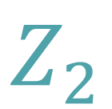


MFA – Step 2
Each table is then normalized by dividing by their first singular value:
Assessor 1
Assessor 1
x
=
$$Z_{1}$$
$$γ_{1}^{−1}$$
Assessor 2
Assessor 2
x
$$γ_{1}^{−1}$$
=
$$Z_{2}$$
Assessor 8
Assessor 8
x
=
$$Z_{8}$$
$$γ_{1}^{−1}$$

Slide 129
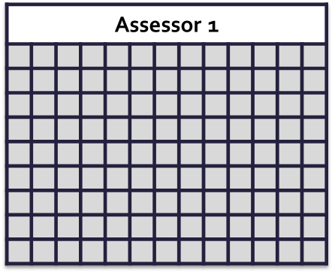
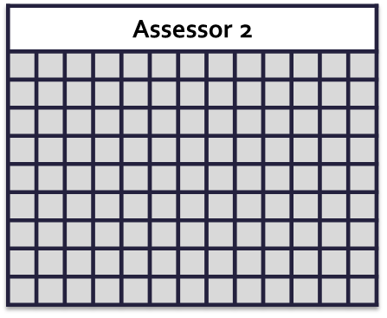
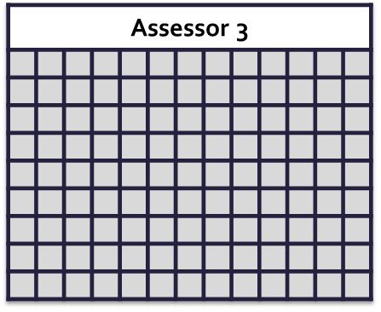
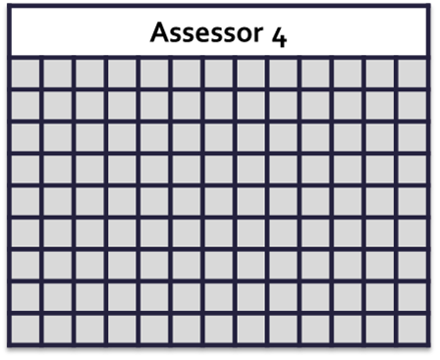
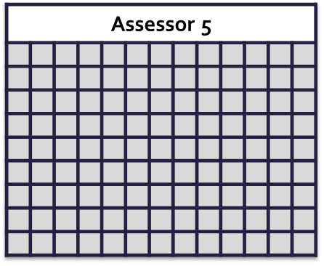
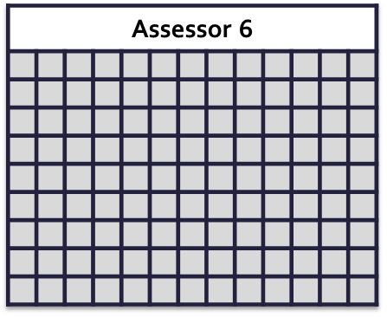
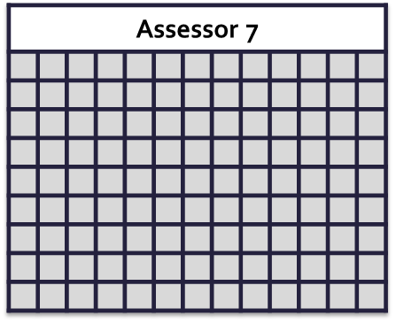
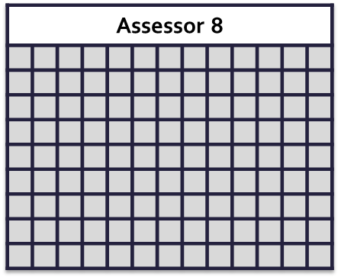
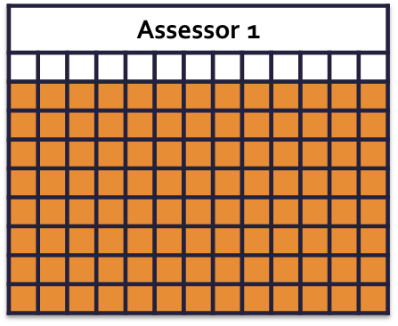
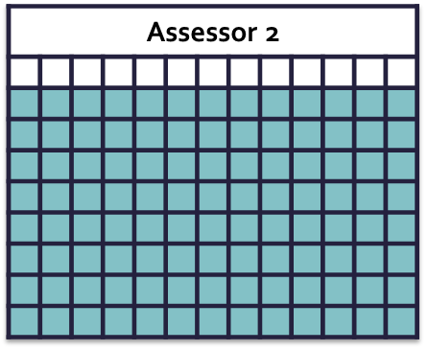
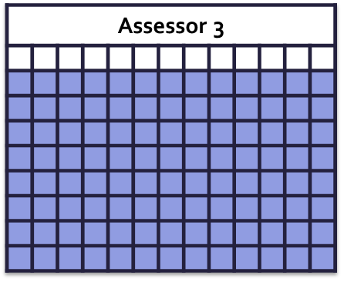
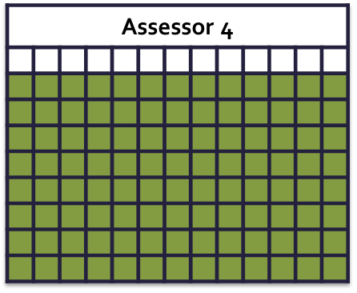
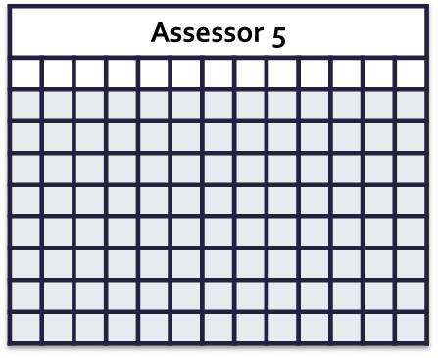
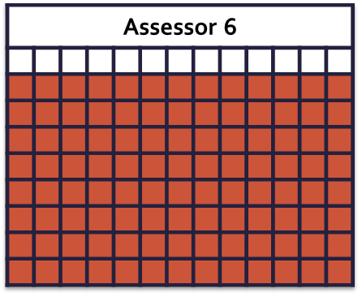
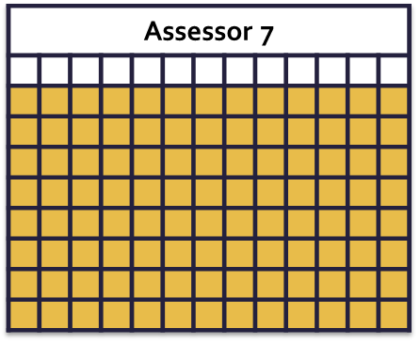
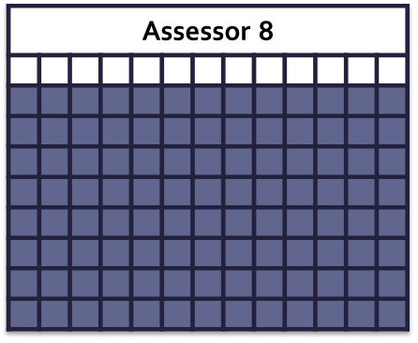
MFA – Step 3
Concatenate normalized tables into one compromise table:

Slide 130
MFA – Step 3
Concatenate normalized tables into one compromise table:

Slide 131




MFA – Step 4
Concatenate normalized tables into one compromise table and run PCA over this:
PCA
1
2

Slide 132
Questions that MFA can answer:
How did participants, collectively, rate the beers?
Did region influence beer ratings?
How did each individual rate the beers?
What was the contribution of each individual to the compromise space?
What do demographics (gender, if someone is a homebrewer, expertise) tell us?
Notes:
Go through each question to informally introduce what we are going to be doing. Structure of the beers across all variables as rated by assessors. Also, post-hoc way. Post-hoc ranges from novice to connesoeur where cons can identify styles and ingredients based on smell and taste.

Slide 133
Let’s take a look in R
File: 2a_MFA.R – the analysis
Notes:
DB PICK UP HERE.

Slide 134
Let’s take a look in R
Notes:
Take them through the next slides slowly, and describewhat kind of matrix each variable is.

Slide 135
Let’s take a look in R

Slide 136
Let’s take a look in R
The data

Slide 137
Let’s take a look in R

Slide 138
Let’s take a look in R
Design matrix for the columns – tells us which set of columns belongs to which matrix (i.e., which participant)

Slide 139
Let’s take a look in R

Slide 140
Let’s take a look in R
Design matrix for the rows – tells us about the beer: is it from Texas, from France, or one of the 2 collaborations between French & Texas breweries?

Slide 141
A look at the component variance
Our trusty friend, the scree plot!
Notes:
Switch to R and show the first graph – walk through the input arguments on the plot.battery() function?

Slide 142
A look at the component variance
Our trusty friend, the scree plot!
Notes:
Switch to R and show the first graph – walk through the input arguments on the plot.battery() function?

Slide 143
A look at the component variance
It looks like we have 2 Components.
  So we’ll just focus on interpreting those.
Notes:
Switch to R and show the first graph – walk through the input arguments on the plot.battery() function?

Slide 144
Questions that MFA can answer:
How did participants, collectively, rate the beers?
Did region influence beer ratings?
How did each individual rate the beers?
What was the contribution of each individual to the compromise space?
What do demographics (gender, if someone is a homebrewer, expertise) tell us?
Notes:
Go through each question to informally introduce what we are going to be doing.

Slide 145
Questions that MFA can answer:
How did participants, collectively, rate the beers?
Did region influence beer ratings?
How did each individual rate the beers?
What was the contribution of each individual to the compromise space?
Did gender and expertise influence the compromise space?
Notes:
Switch to R and show the first graph – walk through the input arguments on the plot.battery() function?

Slide 146
IPA Characteristics
Higher Alcohol
Higher Bitterness
Higher Aroma
Notes:
May need to semi-animate this with shapes to help illustrate what is different/same, what Components could mean. Component 1 is from left to right, you get more and more “IPA” qualities – higher alcohol, higher bitterness, higher aroma, etc…
For those of you that are familiar with these beers…

Slide 147
Questions that MFA can answer:
How did participants, collectively, rate the beers?
Did region influence beer ratings?
How did each individual rate the beers?
What was the contribution of each individual to the compromise space?
Did gender and expertise influence the compromise space?

Slide 148
Notes:
We should include here an arrow that pops in to show that C1 is (left to right) how extreme of an IPA you are: a non IPA all the way through the hoppiest, maltiest, and highest alcohol IPA.
Talk about first component fully first, then second.
Put in BARYCENTERS. Try to understand second component (mission) via columns.

Slide 149
toffee
herbal
bread
farmyard
Notes:
Actually this helps if we highlight just some things along axis 2.
Axis 1 we knw from other stuff. Here, we can say tht Axis 2 is driven by a lot of variance within the French IPAs; a variance that is orthogonal to the “IPA-ness” of the beer. Each French IPA appears to fall relatively in the middle of the IPA gradient here.
FOCUS on Mission – toffee is not really in American IPAs, rather is more English = Herbal
But, what makes them different from one another is that Mission (top) is driven by bread and toffee notes in the malt, with a number of herbal hop notes – which is reminiscent of the more traditional/classic IPA style (instead of these new-fangled Americanized IPAs).

Slide 150
Questions that MFA can answer:
How did participants, collectively, rate the beers?
Did region influence beer ratings?
How did each individual rate the beers?
What was the contribution of each individual to the compromise space?
Did gender and expertise influence the compromise space?

Slide 151
Retaining participant scores
We ‘lose’ the individual participants in the compromise space.
However, we want to know how individual participants “interpret” the compromise space (Abdi & Valentin, 2007).
So, how do we retain individual scores?

Slide 152
Partial factor scores
Partial factor scores are projections of individual factor scores onto the compromise space.
Z₂
Q₂
F₂
 | F1 | F2
SS1
SS2
SS3
SS4
SS5
=

Slide 153
Notes:
May need to semi-animate this with shapes to help illustrate what is different/same, what Components could mean. Component 1 is from left to right, you get more and more “IPA” qualities – higher alcohol, higher bitterness, higher aroma, etc…

Slide 160
Questions that MFA can answer:
How did participants, collectively, rate the beers?
Did region influence beer ratings?
How did each individual rate the beers?
What was the contribution of each individual to the compromise space?
Did gender and expertise influence the compromise space?

Slide 161
Understanding table contributions
In MFA, each table is exerting influence on the compromise space.
How can we understand these individual influences?
Further, how do we understand the relationship between individuals?
Notes:
Not set on the phrasing here.

Slide 162
Partial Inertias
Partial inertias allow us to understand the relationship between participants and the influence of each participant to each component.
Each table accounts for a certain amount of variance along each component
Partial inertias are the proportion of total variance along each component that each table accounts for.

Slide 163
Component 2
Component 1

Slide 164
Questions that MFA can answer:
How did participants, collectively, rate the beers?
Did region influence beer ratings?
How did each individual rate the beers?
What was the contribution of each individual to the compromise space?
What do demographics (gender, if someone is a homebrewer, expertise) tell us?

Slide 165
Some additional code
File: 2b_PicturesAndDetails.R

Slide 167
Questions that MFA can answer:
How did participants, collectively, rate the beers?
Did region influence beer ratings?
How did each individual rate the beers?
What was the contribution of each individual to the compromise space?
What do demographics (gender, if someone is a homebrewer, expertise) tell us?

Slide 168
Questions that MFA can answer:
How did participants, collectively, rate the beers?
Did region influence beer ratings?
How did each individual rate the beers?
What was the contribution of each individual to the compromise space?
What do demographics (gender, if someone is a homebrewer, expertise) tell us?

Slide 171
Questions that MFA can answer:
How did participants, collectively, rate the beers?
Did region influence beer ratings?
How did each individual rate the beers?
What was the contribution of each individual to the compromise space?
What do demographics (gender, if someone is a homebrewer, expertise) tell us?

Slide 173
Notes:
Focus on component 1 only. Homebrewers are pulling apart, and non are pulling toward center.

Slide 174
Questions that MFA can answer:
How did participants, collectively, rate the beers?
Did region influence beer ratings?
How did each individual rate the beers?
What was the contribution of each individual to the compromise space?
What do demographics (gender, if someone is a homebrewer, expertise) tell us?

Slide 175
Notes:
The more transparent, the less expertise.

Slide 176
Notes:
The more transparent, the less expertise.
By now, it’s pretty clear that expertise and homebrewing go hand-in-hand, but also appears that those with expertise drive the first component (which defines a nice spectrum of “IPA-ness”). Where as the lower the expertise appears to drive the second component, likely due to more difficult descriptors (e.g., bready, spice, fruity, toffee).

Slide 177
Recap
In summary…

Slide 178
Notes:
This final slide should be an animation of all the maps (of the rows) that got us to our understanding – starting with this, then the individuals by beer color, then individuals by their own color, then all the demogrpahics stuff.

Slide 182
Notes:
The more transparent, the less expertise.
By now, it’s pretty clear that expertise and homebrewing go hand-in-hand, but also appears that those with expertise drive the first component (which defines a nice spectrum of “IPA-ness”). Where as the lower the expertise appears to drive the second component, likely due to more difficult descriptors (e.g., bready, spice, fruity, toffee).

Slide 183
Double Phew.
Notes:
We have to be at 50+/-2 minutes here.

Slide 184
Overview
Data sets are getting big and complex.
Problems with big data.
Potential solution – Multiple Factor Analysis.
Beer!
More advance topics

Slide 185
Taking MFA further
How do we know exactly which components are important?
How do we know which variables are important?
How do we know if, e.g., demographics are important?

Slide 186
Taking MFA further
Resampling
Resampling
Resampling
Resampling

Slide 187
Taking MFA further
Bootstrap Resampling – Stability of items and groups
Split-half Resampling – Reproducibility of components
Jackknife Resampling – Predictability of individuals
Permutation Resampling – Test the null (variance explained)

Slide 188
Taking MFA further
What if my structure is more complex?
What if I required a different normalization?

Slide 189
Taking MFA further
Numerous variants of MFA for mixed data, path-modeling, and MDS-like approaches

Slide 190
For example
What if you need a different normalization?
  STATIS
What if you have mixed data types?
  MFACT and heterogenous MFA
What if you have distance tables?
  DiSTATIS
What if you have groups on the rows?
  MuBADA and MuDiCA
And so many more

Slide 191
Fin
Questions, comments, complaints?

Slide 192
References
Abdi, H., & Valentin, D. (2007). DISTATIS: the analysis of multiple distances matrices. In Encyclopedia of Measurement and Statistics (pp. 284–290).
Abdi, H., Williams, L. J., & Valentin, D. (2013). Multiple factor analysis: principal component analysis for multitable and multiblock data sets. Wiley Interdisciplinary Reviews: Computational Statistics, 5(2), 149–179. http://doi.org/10.1002/wics.1246
Williams, L., Abdi, H., French, R., & Orange, J. (2010). A tutorial on Multi-Block Discriminant Correspondence Analysis (MUDICA): A new method for analyzing discourse data from clinical populations. Journal of Speech, Language and Hearing Research, 53.
Abdi, H. (2007). Analyzing assessors and products in sorting tasks: DISTATIS, theory and applications. Food Quality and Preference, 18(4), 627–640. http://doi.org/10.1016/j.foodqual.2006.09.003
Beaton, D., Fatt, C. R. C., & Abdi, H. (2014). An ExPosition of multivariate analysis with the singular value decomposition in R. Computational Statistics & Data Analysis, 72(0), 176 – 189. http://doi.org/http://dx.doi.org/10.1016/j.csda.2013.11.006
Bécue-Bertaut, M., & Pagès, J. (2008). Multiple factor analysis and clustering of a mixture of quantitative, categorical and frequency data. Computational Statistics & Data Analysis, 52(6), 3255–3268. http://doi.org/10.1016/j.csda.2007.09.023
Hesterberg, T. (2011). Bootstrap. Wiley Interdisciplinary Reviews: Computational Statistics, 3, 497–526. http://doi.org/10.1002/wics.182
Strother, S. C., Anderson, J., Hansen, L. K., Kjems, U., Kustra, R., Sidtis, J., … Rottenberg, D. (2002). The quantitative evaluation of functional neuroimaging experiments: the NPAIRS data analysis framework. NeuroImage, 15(4), 747–771.

Slide 193
Material
Found at:
http://www.derekbeaton.com/samr-swpa-2016/

