Slide 1

Reproducible components through split-half resampling: another look at stopping rules.
Derek Beaton Hervé Abdi
School of Behavioral and Brain Sciences
The University of Texas at Dallas, TX, USA

Slide 2
Why Split-half Resampling?
How reproducible are our effects?

Slide 3
Outline
Resampling with a baby example
Principal Components Analysis
Split-half for PCA (and similar techniques)
Split-half in action!

Slide 4
Our example data
Beer ratings on two sensory categories
  38 beers
  How hoppy are these beers?
  How floral are these beers?
  Scale from 0 (not present) to 5 (very present)
Simple correlation

Slide 5
How it looks

Slide 7
Recall: How it looks

Slide 8
How it looks
Beers | Hoppy | Floral
Brother David Tripel | 1 | 1
The Reverend | 2 | 2.5
… | … | …
La Folie | 0 | 1
Beers | Hoppy | Floral
Sisyphus | 3 | 2
Pliny The Elder | 3.5 | 3
… | … | …
Consecration | 0 | 0

Slide 9
How it looks
Beers | Hoppy | Floral
Brother David Tripel | 1 | 1
The Reverend | 2 | 2.5
… | … | …
La Folie | 0 | 1
Beers | Hoppy | Floral
Sisyphus | 3 | 2
Pliny The Elder | 3.5 | 3
… | … | …
Consecration | 0 | 0
Exclusive data sets

Slide 11
Exclusive data sets

Slide 12
Resampling Requires Computation
We have to perform a resampling procedure
  Over
  Over
  Over
  Over
  Over
  Again

Slide 13
Save the values
1
2
3 | …
4 | …
5 | …
… | …
… | …
998 | …
999 | …
1000
1
2
3 | …
4 | …
5 | …
… | …
… | …
998 | …
999 | …
1000

Slide 14
Save the values
1 | 0.713
2 | 0.46
3 | …
4 | …
5 | …
… | …
… | …
998 | …
999 | …
1000 | 0.41
1 | 0.418
2 | 0.76
3 | …
4 | …
5 | …
… | …
… | …
998 | …
999 | …
1000 | 0.71
Exclusive data sets

Slide 15
Split v. Split?
Dawn of Justice

Slide 18
Not a whole lot changes
We see that the values tend to be the same across the two splits for many iterations
No matter how we split the data:
  Floral and Hoppy are strongly, positively correlated

Slide 19
Not a whole lot changes
We see that the values tend to be the same across the two splits for many iterations
No matter how we split the data:
  Floral and Hoppy are strongly, positively correlated

Slide 20
So how can we use this?
Especially for multivariate research?

Slide 21
Outline
Resampling with a baby example
Principal Components Analysis (PCA)
Split-half for PCA (and similar techniques)
Split-half in action!

Slide 22
Principal Components Analysis
One of the oldest & ubiquitous
Orthogonawesome
  Components are orthogonal
Breaks a data matrix into 3 parts:
  Observations x Components
  Variables x Components
  Variance per Component (eigenvalues)

Slide 23
Principal Components Analysis
One of the oldest & ubiquitous
Orthogonawesome
  Components are orthogonal
Breaks a data matrix into 3 parts:
  Observations x Components
  Variables x Components
  Variance per Component (eigenvalues)

Slide 24
Toy Example
20 Words
2 Variables
  # letters
  # definitions

Slide 25
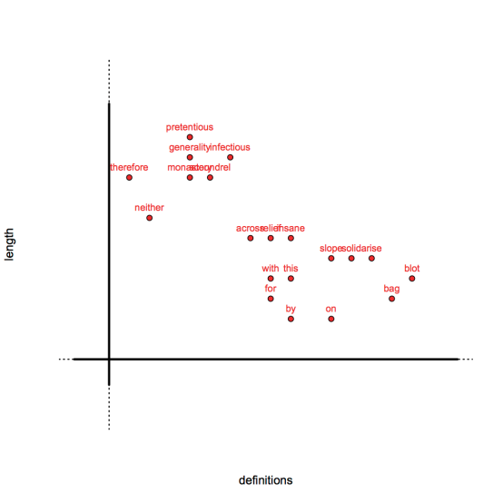

Slide 26
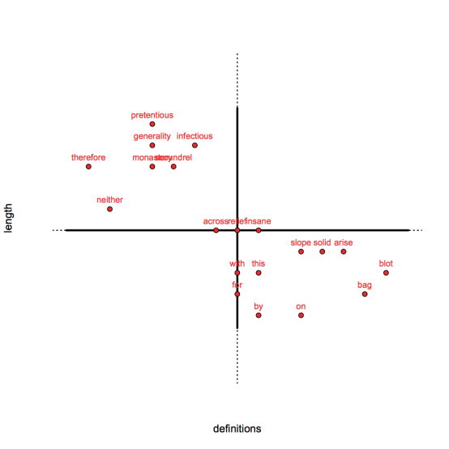

Slide 27


Slide 28
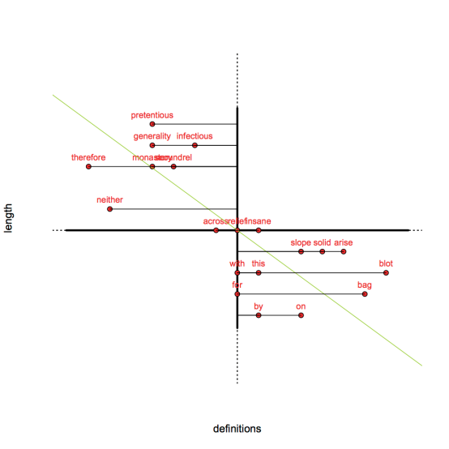

Slide 29
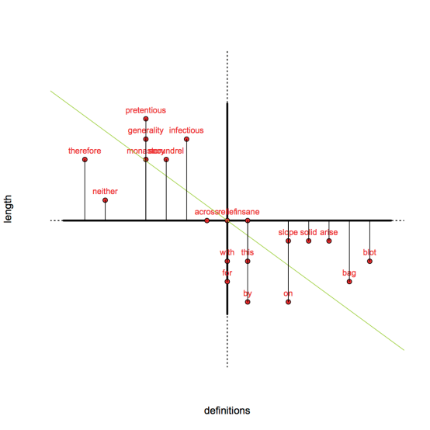

Slide 30
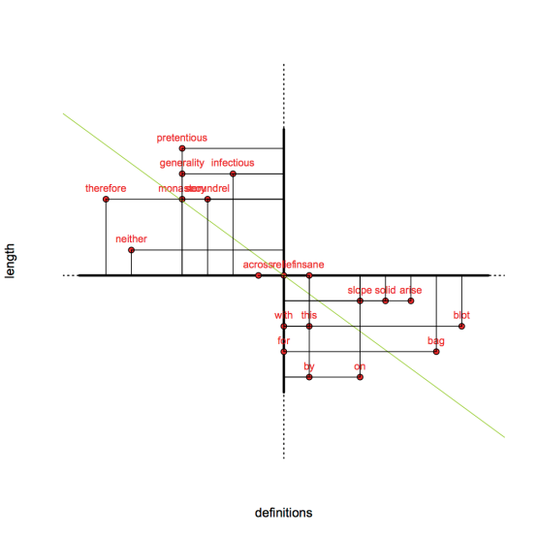

Slide 32
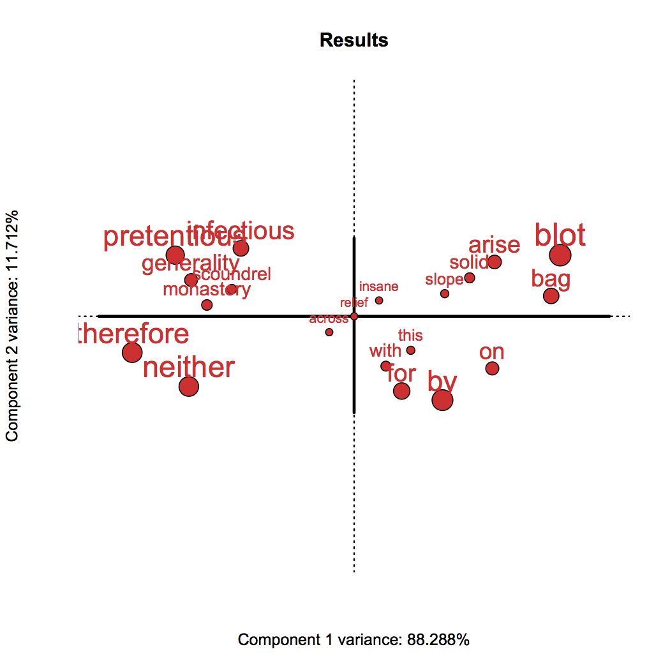

Slide 33
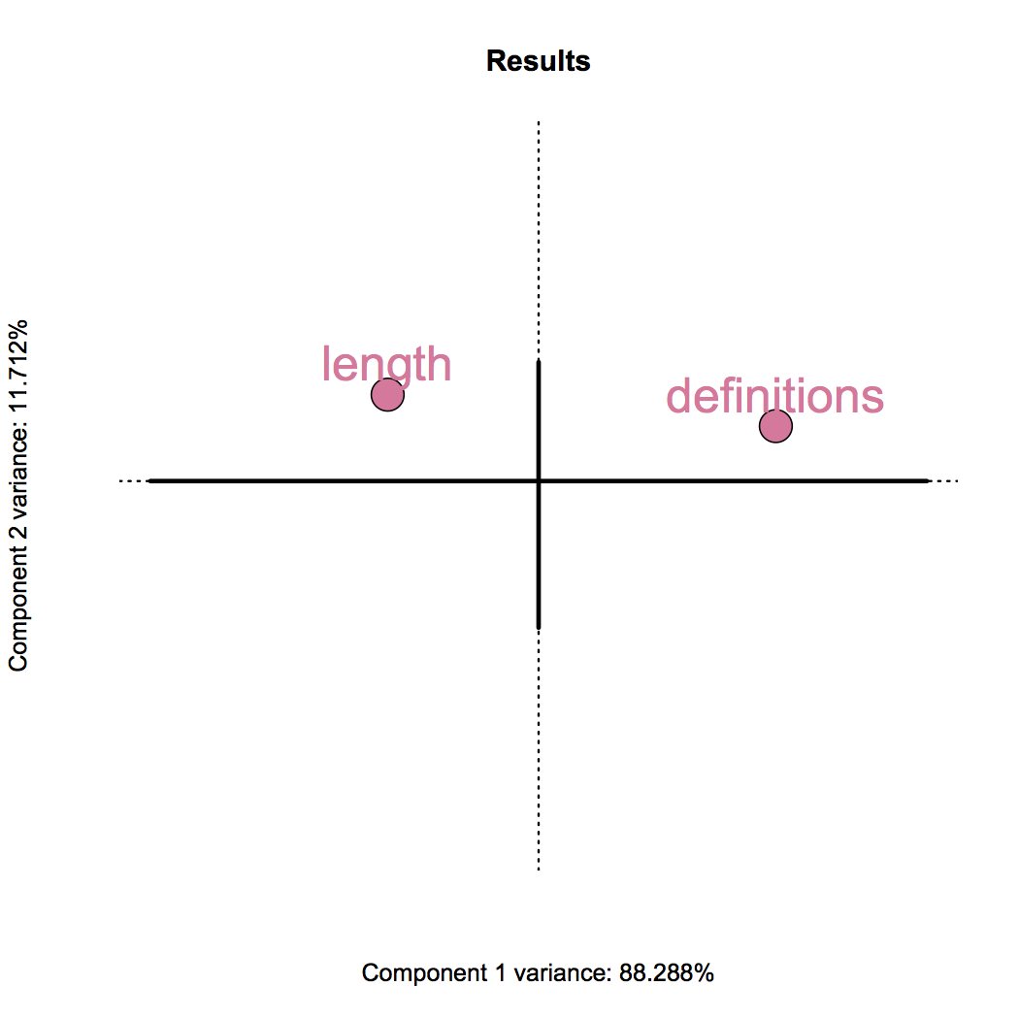

Slide 34
Back to beer
Same 38 beers
16 variables
  across smell and taste
  for hop, malt, and yeast qualities
Do a PCA!

Slide 36
The beers
Color coded by style
These are our observations

Slide 37
PCA (and other techniques)
We have to interpret the Components
  What do they mean?
  What kind of information do they reflect?
  What can we better understand about our data?
    Both observations and variables
We need a story

Slide 38
The variables
Look at our variables
Components (horizontal and vertical axes) are created from these variables.
  i.e., they are combinations of variables
They tell us the story

Slide 42
These aren’t the only two
Beer data has 16 components
  If you think that’s a lot… just wait for the good stuff

Slide 43
But how many Components?
An age old question: how many components do we interpret? How many are worth it?
Usually, we use variance

Slide 44
A classic approach
The scree plot!
  broken stick criterion or
  Kaiser’s (mean) cut off

Slide 46
Broken stick!

Slide 47
Just Component 1

Slide 49
Mean variance

Slide 50
Now 6 Components!

Slide 51
So which is it?

Slide 52
We really want to know
Which components are most likely to generalize beyond our data?

Slide 53
Split half to the rescue!

Slide 54
Outline
Resampling with a baby example
Principal Components Analysis
Split-half for PCA (and similar techniques)
Split-half in action!

Slide 55
How it looks
Beers | Hoppy | Floral
Brother David Tripel | 1 | 1
The Reverend | 2 | 2.5
… | … | …
La Folie | 0 | 1
Beers | Hoppy | Floral
Sisyphus | 3 | 2
Pliny The Elder | 3.5 | 3
… | … | …
Consecration | 0 | 0
Exclusive data sets

Slide 56
Two PCAs
Over and over and over again
  Like other resampling approaches, the more the better
  But usually 1000 is good enough

Slide 58
Exclusive data sets

Slide 59
“Same” Components?
Can we get the same components (i.e., variance-based configuration of variables) for each split?

Slide 61
MAYBE?!

Slide 65
That’s not easy!
What if we have to do that 500, 1000, or 1 million times?!

Slide 66
Let’s just correlate
We repeat the split-half 500 times
Save the column factors for each split, on each iteration
And compute correlation between the variable component scores
  Tells us similarity per split!

Slide 67
Let’s just correlate
We repeat the split-half 500 times
Save the column component scores for each split, on each iteration
And compute correlation between the variable component scores
  Tells us similarity per split!

Slide 68
Let’s just correlate
We repeat the split-half 500 times
Save the column component scores for each split, on each iteration
And compute correlation between the variable component scores
  Tells us similarity per split!

Slide 69
Let’s just correlate
We repeat the split-half 500 times
Save the column component scores for each split, on each iteration
And compute correlation between the component scores
  Tells us similarity per split!

Slide 70
Make a heat map
Average correlation over the splits
Visualize
  Heatmaps tell us where values are at their extremes
  i.e., visualize high correlation (reproducibility)

Slide 74
Neat!
Over 500 iterations we know that:
  Component 1: Average r = 0.82
  Component 2: Average r = 0.47
  The rest aren’t good!

Slide 76
Not too different
But different enough
And tells us much, much more

Slide 77
Outline
Resampling with a baby example
Principal Components Analysis
Split-half for PCA (and similar techniques)
Split-half in action!

Slide 78
Semantic Analysis
Alhazmi, Beaton, & Abdi (in prep)
Multivariate analysis of abstracts from the NeuroSynth database

Slide 79
NeuroSynth
Database to record fMRI studies
Keeps track of which voxels were reported
Key words
Studies
Meta analysis tools

Slide 80
Our question
What is the factor structure of the abstracts?
  A latent semantic analysis.

Slide 81
It’s big!
10,898 Abstracts
3,114 unique terms across all of them
Which terms are used in which abstracts?
  And how many times are they used?

Slide 82
Example of Data
PMID | abus | addict | … | episod | autobio
1001 | 0 | 0 |  | 1 | 2
1002 | 1 | 2 |  | 1 | 0
4567 | 1 | 0 |  | 0 | 0
345 | 3 | 1 |  | 0 | 0
… | … | … | … | … | …
12034 | 0 | 0 |  | 0 | 0
3412 | 0 | 1 |  | 0 | 1
8745 | 1 | 4 |  | 0 | 0
100001 | 0 | 0 |  | 3 | 1

Slide 83
PCA TO THE RESCUE.

Slide 84
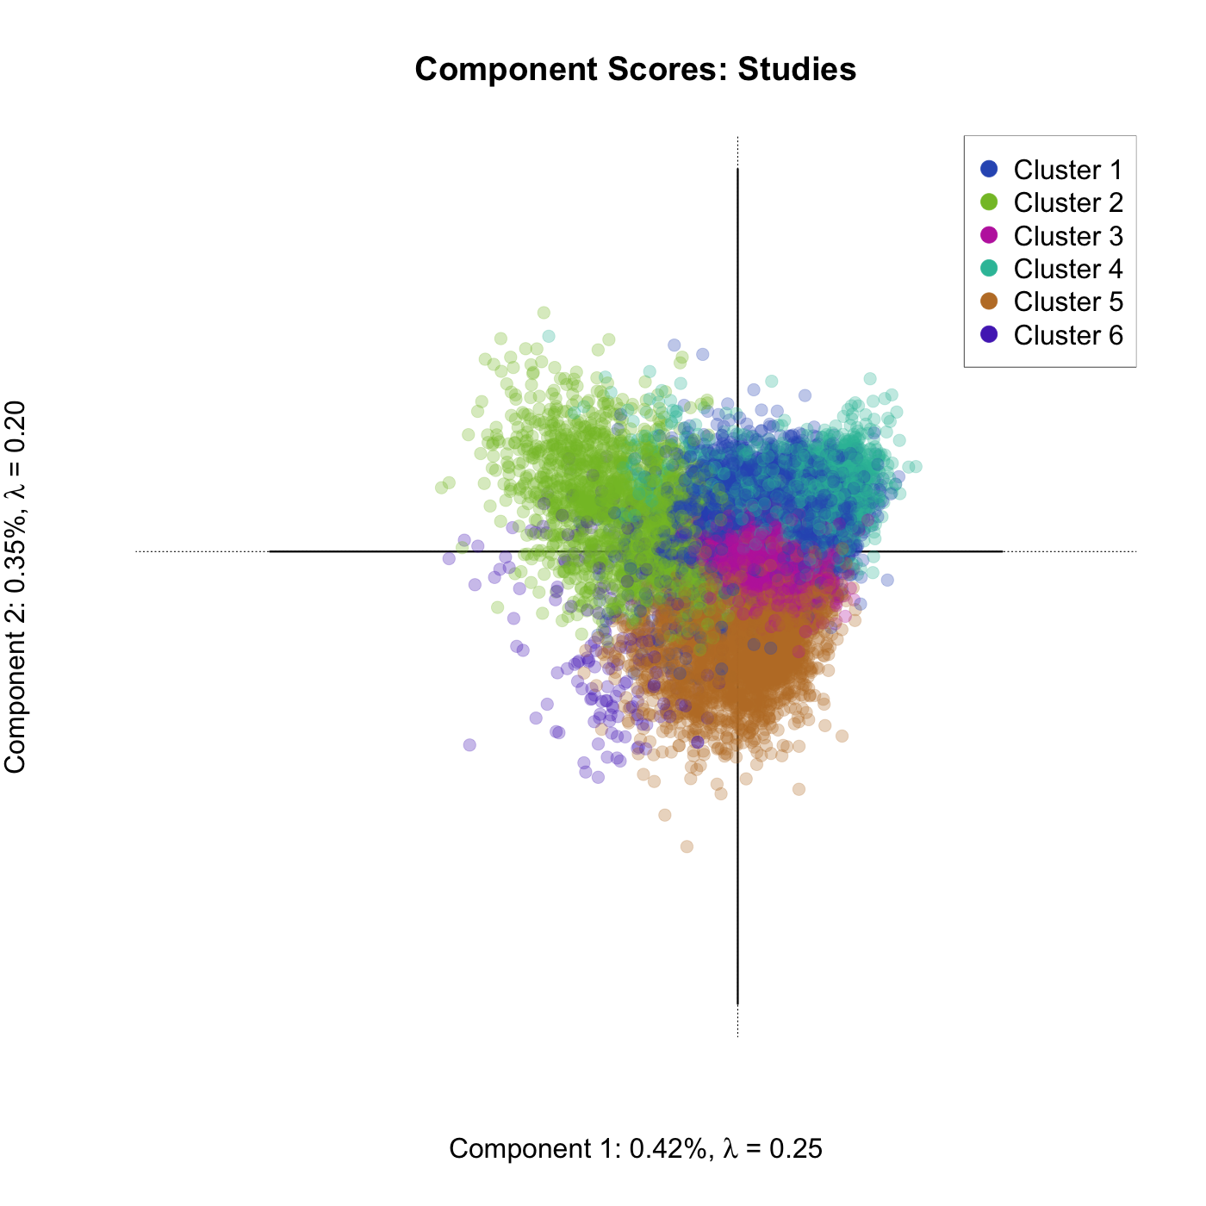

Slide 85
That’s only 2
Of 3,112 components!
  We couldn’t convince anyone to interpret that many components.
  We tried!

Slide 87
That’s crazy!
How do we decide which components are important for us to interpret?
Scree says 3
  Or 12
  Or > 250

Slide 88
That’s crazy!
How do we decide which components are important for us to interpret?
Scree says 3
  Or 12
  Or > 250

Slide 89
That’s crazy!
How do we decide which components are important for us to interpret?
Scree says 3
  Or 12
  Or > 250

Slide 91
What does split half say?
Really, we want to know which components can be reproduced now matter how we split the data
Goal: find the components that are likely to generalize

Slide 92
Let’s just look at the first 20
Split half 1000 times
Correlated component scores across each split

Slide 93
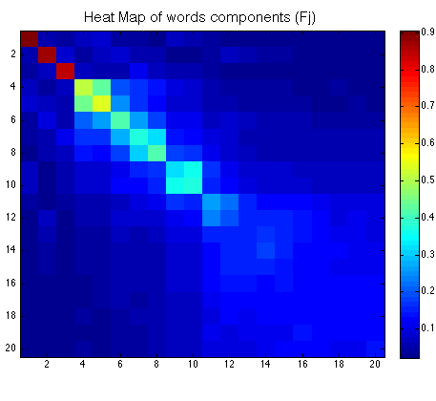
3 or 5 out of 3112!

Slide 94
Saved us a lot of interpretation!
Impossible to interpret too many Components

Slide 95
Generalizable
And tells us which Components keep coming up
  Not just by variance, but by how similar they are each time

Slide 96
Take aways
Split-half is your new friend
  Helps us in ways Monte Carlo, Permutation, and Bootstrap can’t.
Big point: identify which components keep coming up in the data

Slide 97
Fin
Materials available at:
http://www.derekbeaton.com/samr-swpa-2016/

